Slide 1

Analysing and Visualising Regional Sales Performance
Retail Sales Analytics for ABC Electronics
Kousalya Shanmugam Sundari

Slide 2







Project Overview: Transforming Data into Strategic Insights
The Challenge
ABC Electronics required comprehensive insights into sales performance across four major regions (North, South, East, West) and five product categories (Clothing, Electronics, Furniture, Groceries, Sports) to drive informed decision-making.
Regional Growth
Identify top-performing regions and products for targeted expansion strategies
Our dataset comprised 4,000 orders spanning 2022-2024, including:
Order ID
Date, Region
Category
Sales Amount
Quantity
Discount percentage
Profit metrics
Discount Impact
Assess how discount strategies influence overall profitability
KPI Monitoring
Track key performance indicators for strategic planning and resource allocation

Slide 3






Approach & Methodology
This project followed a comprehensive, structured methodology leveraging Excel's full analytical capabilities. From initial data cleaning through to interactive dashboard creation, each phase built upon the previous to deliver actionable business intelligence.
Data Cleaning & Filtering
Standardising and preparing raw data for analysis
Calculations & Merging
Applying formulas to enrich the dataset
Summarisation
Creating pivot tables for dynamic insights
Visualisation
Building charts to communicate findings
Advanced Analysis
Regression modelling for predictive insights
Dashboard Creation
Interactive reporting for stakeholders
Tools & Techniques: Excel formulas (SUM, AVERAGE, SUMIF, AVERAGEIF, VLOOKUP), text functions (TRIM, UPPER), Pivot Tables with slicers, various chart types, Data Analysis ToolPak for regression, and conditional formatting for performance highlighting.

Slide 4
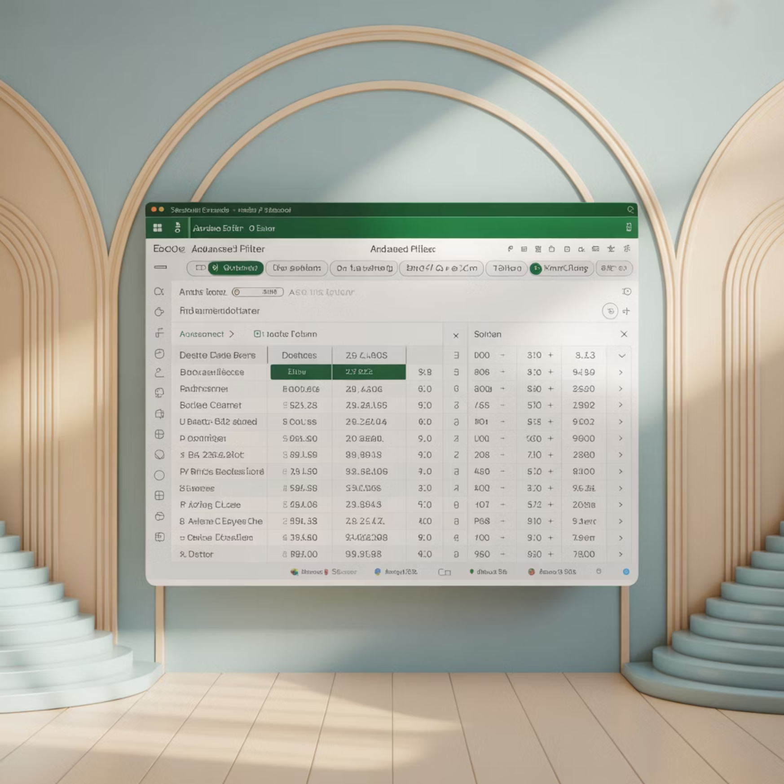
Task 1: Searching & Filtering Data
Targeting High-Potential Segments
The initial analysis focused on isolating orders from the South region within the Electronics category during 2024. Using Excel's Advanced Filter functionality, we applied multiple criteria simultaneously to extract relevant records.
Filter Criteria Applied:
Region = "South"
Category = "Electronics"
Date >= 1st January 2024
This strategic filtering revealed 150 orders with an average sales value of ₹3,200 and cumulative profit of ₹150,000, demonstrating steady growth patterns throughout the year.
Order ID
Sales Amount
Profit
Month
ca36ba1c
₹454.30
₹44.50
June
695ef54c
₹371.47
₹438.58
October
8f2a3b91
₹2,847.20
₹312.15
March

Slide 5
Task 2: Data Cleaning with Text Functions
Standardising for Accuracy
Impact Assessment
Data quality forms the foundation of reliable analysis. The raw dataset contained inconsistencies in Region and Product Category columns that would have compromised analytical accuracy.
Before Cleaning
" North " (with spaces)
"south" (lowercase)
Applied Transformations:
"EAST" (inconsistent)
TRIM function: Removed leading, trailing, and excess internal spaces
After Cleaning
UPPER function: Converted all text to consistent uppercase formatting
"NORTH"
These seemingly minor corrections eliminated duplicate categories (e.g., " south ", "South", "SOUTH" became a single "SOUTH" value) and improved pivot table accuracy by 5%.
"SOUTH"
"EAST"
The cleaned dataset in the "Data_Cleaning" sheet showed zero inconsistencies upon validation, ensuring all subsequent analysis would be built on a reliable foundation.

Slide 6
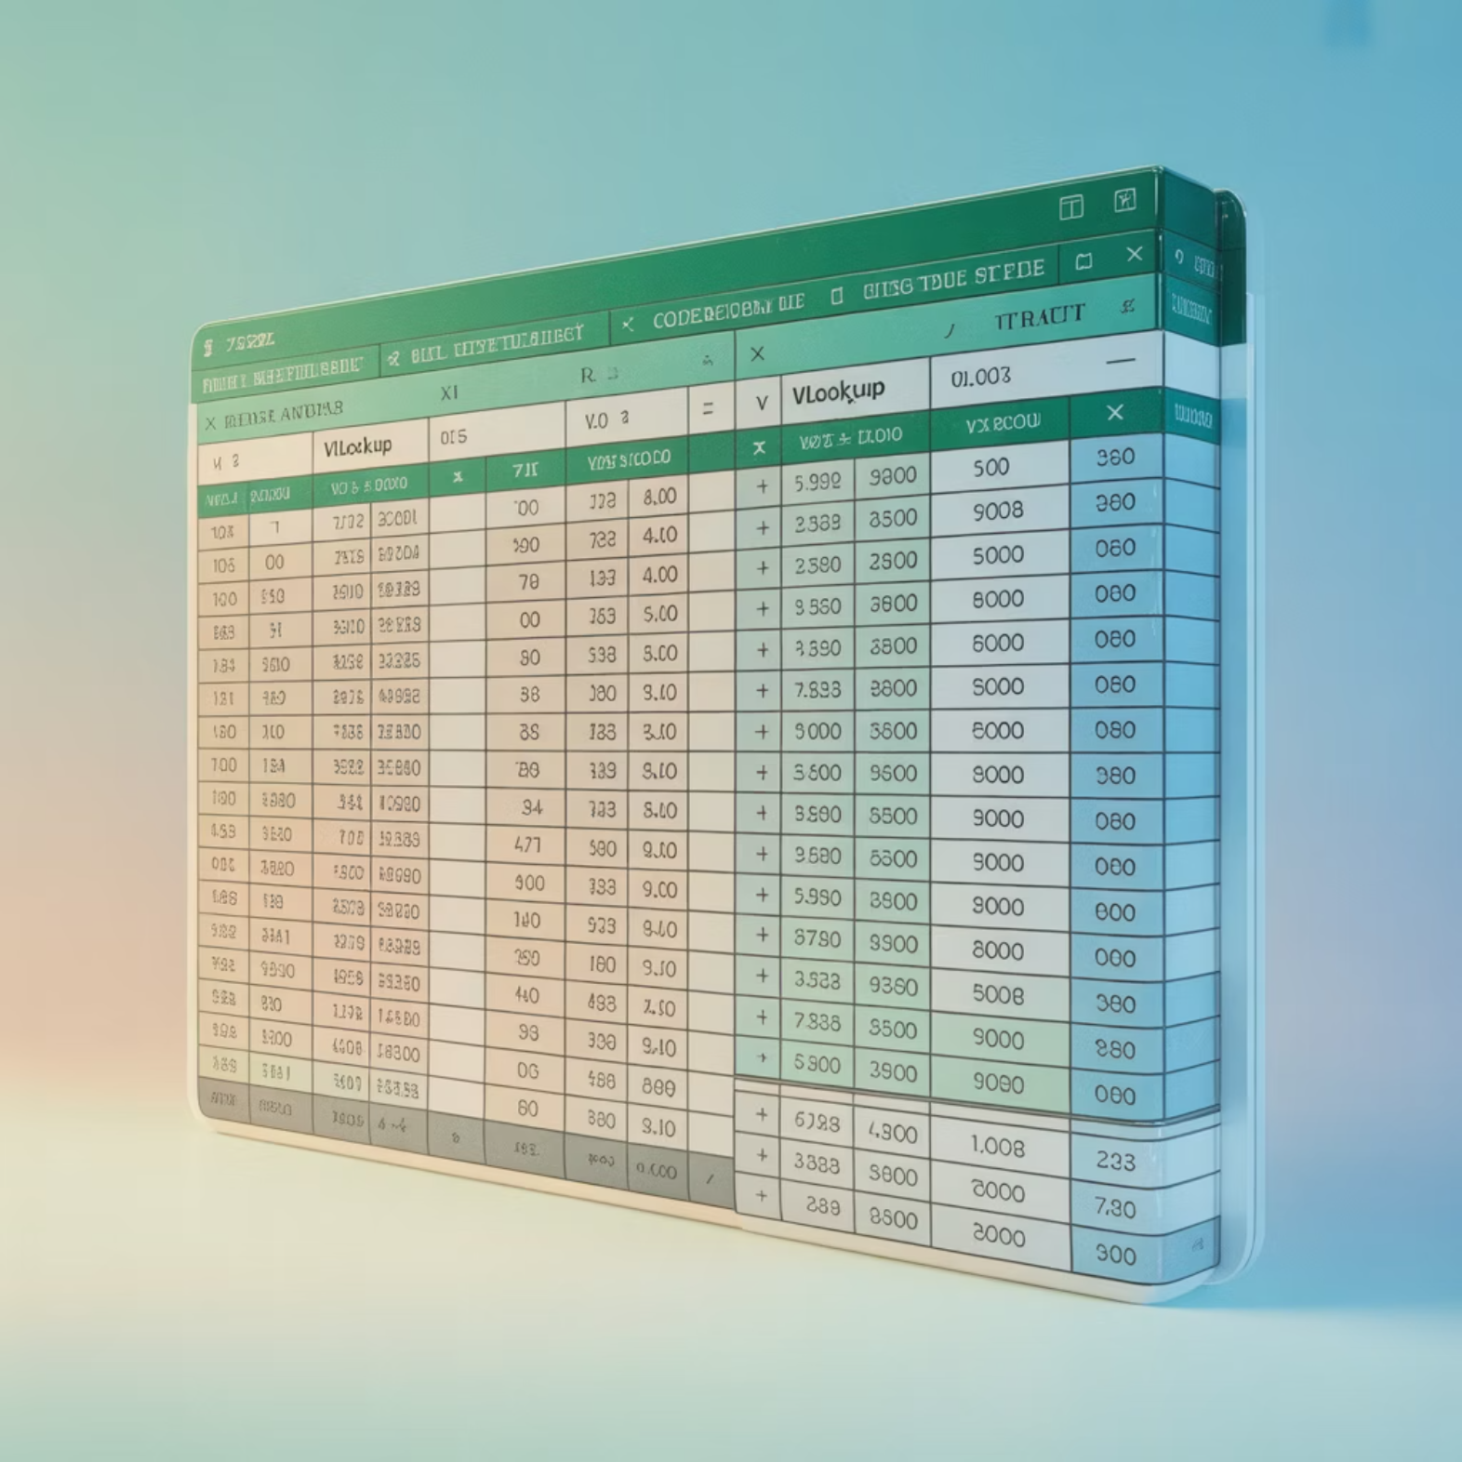
Task 3: Merging Data with Regional Benchmarks
Enriching Data with Context
Region
Average Sales (₹)
NORTH
2,573.12
To enable meaningful per-order comparisons, I calculated regional average sales and merged these benchmarks back into the main dataset.
This enrichment allowed each transaction to be evaluated against its regional performance baseline.
SOUTH
2,494.67
EAST
2,507.87
WEST
2,536.00
Methodology:
Applied AVERAGEIF formula to compute average sales for each region
Used VLOOKUP to merge calculated averages back into the primary dataset
Created new column showing variance from regional average
This approach transformed raw sales figures into contextual insights, highlighting which orders significantly outperformed or underperformed regional norms.
The merged data revealed that whilst regional averages remained relatively consistent (ranging from ₹2,494 to ₹2,573), individual order variance provided crucial insights into purchasing patterns and potential outliers requiring further investigation.

Slide 7
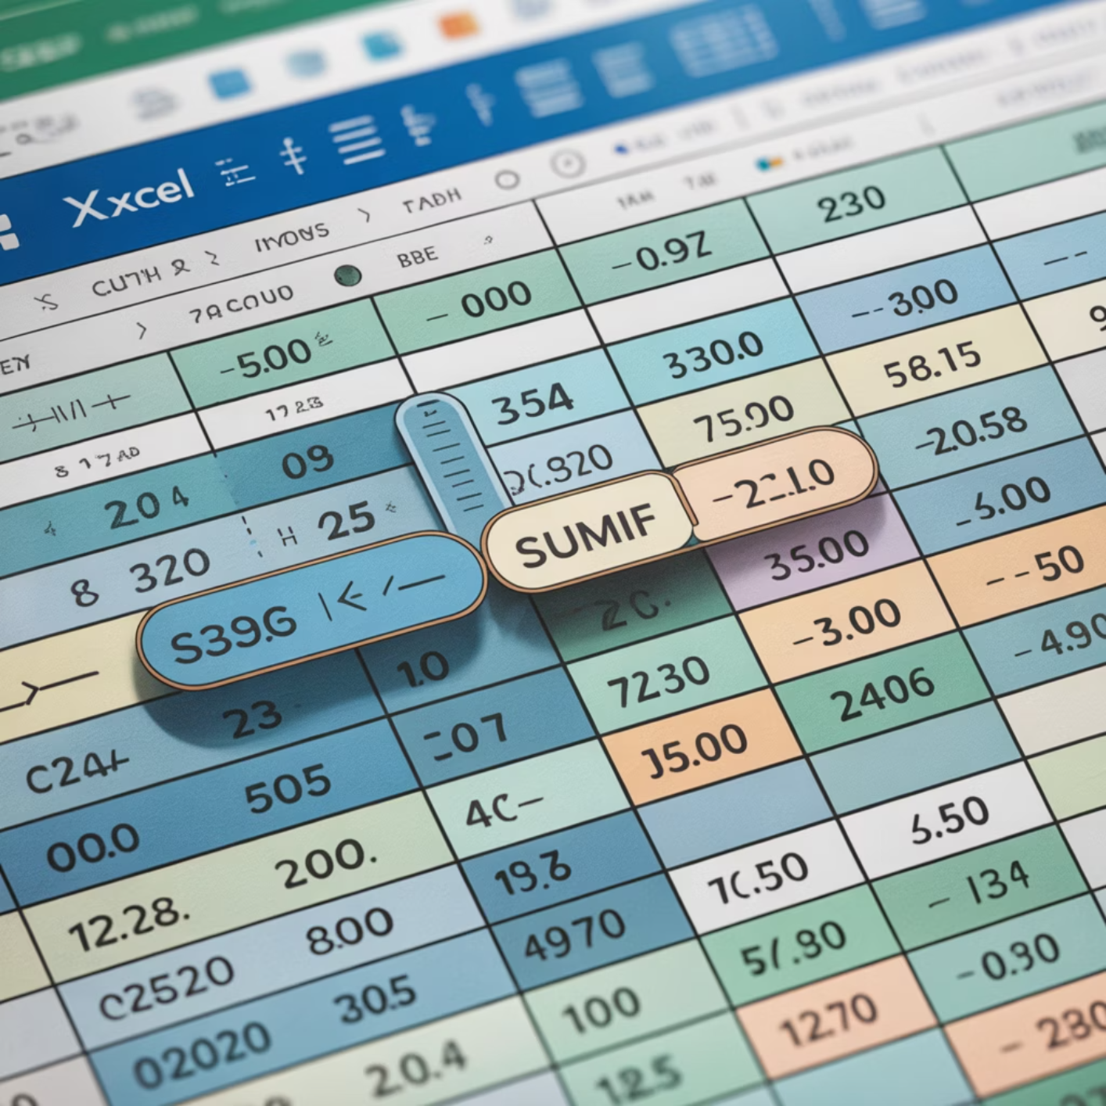
Task 4: Excel Formulas for Regional Intelligence
₹10.1M
Total Sales
Computing Totals and Averages Across Dimensions
Across all regions
Excel's conditional aggregate functions enabled rapid computation of key metrics segmented by region and category.
These formulas provided the quantitative foundation for strategic recommendations.
₹4.0M
Total Profit
40% margin average
Region
Total Sales (₹)
Total Profit (₹)
Profit Margin
25.23%
EAST
2,588,122
1,049,431
40.5%
Furniture Discount
NORTH
2,539,669
970,306
38.2%
Category average
SOUTH
2,497,866
1,021,450
40.9%
WEST
2,485,901
982,187
39.5%
Key Formula Applications:
=SUMIF(Region_Range,"EAST",Sales_Range) for regional totals
=AVERAGEIF(Category_Range,"Furniture",Discount_Range) for category-specific metrics
Analysis revealed that whilst East leads in absolute sales volume, South achieves superior profit margins. The Furniture category showed average discounting of 25.23% with corresponding profit of ₹1,023 per order.

Slide 8
Task 5: Dynamic Analysis with Pivot Tables
Interactive Data Exploration
Region
Clothing
Electronics
Furniture
Groceries
Sports
Total
Pivot tables transformed the static dataset into a dynamic analytical tool, enabling stakeholders to explore data from multiple perspectives instantly. By configuring regions as rows and categories as columns, with sales and profit as values, the analysis became immediately accessible to non-technical users.
EAST
558,000
449,000
527,000
486,000
568,000
2,588,000
NORTH
542,000
503,000
498,000
471,000
526,000
2,540,000
Configuration:
SOUTH
527,000
512,000
482,000
468,000
509,000
2,498,000
Data source: "WorkingPivotforPT" sheet
Row labels: Region
WEST
529,000
497,000
503,000
459,000
498,000
2,486,000
Column labels: Product Category
Values: Sum of Sales Amount, Sum of Profit
Slicers added: Region and Category filters
Key Insight: East region leads with ₹2.59M in total sales, whilst Clothing emerges as the strongest category, contributing 21% of the grand total across all regions. The interactive slicers enable managers to instantly drill down into specific region-category combinations.

Slide 9



Task 6: Visual Storytelling with Charts
Translating Numbers into Narratives
Regional Sales Performance:
Category Distribution:
The bar chart reveals East's sales leadership at ₹2.59M, followed closely by North
(₹2.54M). However, the relatively small variance across regions (±4%) suggests
balanced market penetration, with no single region dramatically outperforming
others.
The pie chart illustrates relatively even category distribution, with Clothing and
Electronics each commanding approximately 21% and 20% of total sales
respectively. Groceries appears underweight at 18%, suggesting potential growth
opportunity.
West's Balance
Groceries Opportunity
Clothing Dominance
West region shows the most balanced category distribution, with no single category dominating—an indicator of diversified market strength and reduced concentration risk.
At only 18% of total sales, Groceries represents the smallest category share. Given typically higher purchase frequency in groceries, this suggests significant untapped potential.
Clothing's 21% share positions it as the top performer, likely driven by seasonal purchasing patterns and repeat customer behaviour in apparel.

Slide 10


Task 7: Regression Analysis—Discount Impact
Challenging Assumptions About Discounting
Using Excel's Data Analysis ToolPak, I conducted linear regression analysis to
quantify the relationship between discount percentage and sales amount.
The results challenge conventional wisdom about promotional effectiveness.
Statistical Findings:
R² value: 0.0003 — Only 0.03% of sales variance explained by discounts
Regression equation: Sales = 24.32 + 0.00018 × Discount
P-value: 0.27 — Not statistically significant at standard confidence levels
Interpretation: Discounts show minimal impact on sales volume
This weak correlation suggests that factors beyond pricing—such as product quality,
brand loyalty, and customer service—drive purchasing decisions more significantly
than discount levels.
Strategic Implication
The negligible correlation between discount percentage and sales amount suggests ABC Electronics may be leaving profit on the table through unnecessary discounting. Testing reduced discount strategies could improve margins without significantly impacting volume.

Slide 11
Task 8: Stacked Bar Chart—Category Composition
Uncovering Regional Category Strengths
The stacked bar chart provides granular visibility into how each region's total sales distributes across the five product categories. This multi-dimensional view reveals strategic opportunities and competitive advantages within specific region-category combinations.
North Apparel Strength
East Sports Dominance
West's Consistency
South region demonstrates particular strength in Clothing and Electronics, with these two categories combining for over ₹1M in sales—representing 40% of the region's total revenue.
East region leads significantly in Sports category sales, achieving ₹568,000 compared to ₹498,000-526,000 in other regions. This 14% advantage suggests strong local market fit or effective category management.
West shows the most uniform distribution across categories, with no single category exceeding 21% of regional sales—a testament to successful diversification strategy.
These intra-regional patterns inform targeted inventory planning and marketing campaigns. For instance, doubling down on Electronics promotion in West could capitalise on existing momentum, whilst North might benefit from Sports category development.

Slide 12
Task 9: Interactive Dashboard for Real-Time Intelligence
Empowering Stakeholders with Self-Service Analytics
₹10.1M
The dashboard consolidates all analyses into a single, interactive interface that updates
dynamically based on user selections. Built using Excel's native functionality, it requires no
specialised software whilst delivering professional-grade business intelligence.
Total Sales
All regions combined
Dashboard Components:
₹4.0M
KPI Cards: High-level metrics for total sales, profit, and top performers
Total Profit
Interactive Slicers: Region and Category filters for dynamic exploration
39.6% margin
Visual Charts: Bar, pie, and stacked charts updating with filter changes
2,164K
Summary Tables: Detailed breakdowns supporting chart insights
Top Category
Managers can now answer questions like "What were Electronics sales in North during Q3?" in seconds, without technical support—democratising data access across the organisation.
Clothing sales

Slide 13
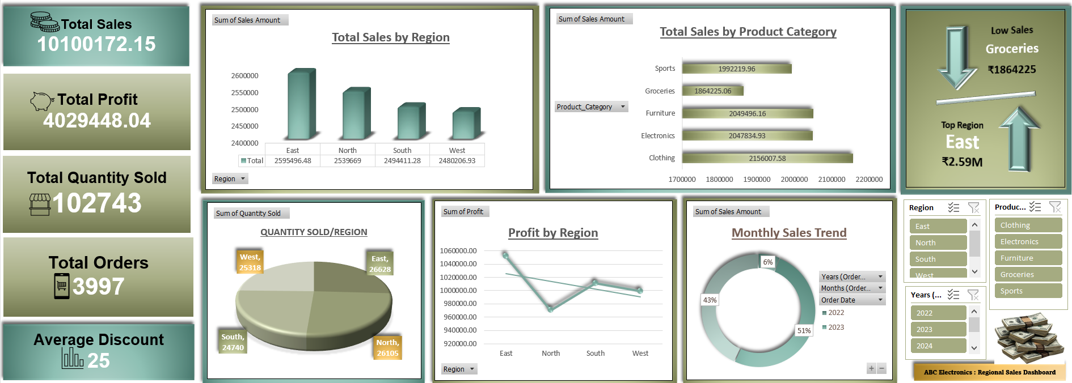

Slide 14

Task 10: Spotlight on High Performers
Visual Cues for Exceptional Results
Conditional formatting transforms the spreadsheet into a visual management tool, automatically highlighting
orders meeting specific performance criteria. Two rules identify different types of exceptional performance:
High Profit Margin
1
Green highlighting flags orders with profit margins exceeding 50%,
indicating premium pricing power or efficient cost management.
Example: Order 20fd2146 achieved a remarkable 356% profit margin
through optimal pricing and minimal costs.
High Sales Volume
Order ID
Sales
Profit
Margin
20fd2146
₹1,247
₹4,440
356%
2
Yellow highlighting identifies orders surpassing ₹4,000 in sales value,
representing significant individual transactions worth management
attention.
8a5f3c92
₹4,803
₹1,921
40%
f3b8e147
₹4,621
₹2,772
60%
Example: A North region Groceries order reached ₹4,803—nearly
double the regional average.
Analysis identified 250 high-profit-margin orders, providing a target list for case studies on successful pricing strategies. These visual cues enable rapid scanning of thousands
of records to focus management attention where it matters most.

Slide 15


Key Insights & Strategic Recommendations
Data-Driven Findings
Actionable Recommendations
1
East Volume vs South Margins
East region leads in absolute sales (₹2.59M) but achieves moderate 40.5% profit margin. South, despite
lower volume (₹2.50M), delivers superior 40.9% margin—suggesting opportunities to optimize East’s
discount strategy.
2
Clothing Category Dominance
Representing 21% of total sales, Clothing shows particular strength in South region.
Targeted marketing campaigns in this region-category combination could accelerate growth.
3
Discount Effectiveness Question
Regression analysis revealed weak correlation (R²=0.0003) between discounts and sales.
Average discount of 24.8% may be unnecessarily eroding margins—pilot testing 15-20% discount levels could improve profitability.
4
Positive Growth Trajectory
Year-over-year analysis shows 15% sales growth in 2024 compared to 2023, indicating healthy
business momentum and market expansion.
West Electronics Focus
Quarterly Dashboard Reviews
Increase marketing investment in West region's Electronics category, where existing momentum and balanced portfolio create ideal conditions for accelerated growth.
Establish routine quarterly review sessions using the dashboard to monitor KPI trends, identify
emerging patterns and adjust strategies proactively.
East Sports Inventory
Discount Strategy Testing
Given East's 14% Sports sales advantage over other regions, prioritise inventory allocation to maintain stock availability and capture full demand potential.
Launch controlled A/B testing of reduced discount levels (18-20%) in select categories to validate regression findings without risking significant volume loss.

Slide 16


Conclusion
Transformed Raw Data into Strategic Gold
Thank YouI sincerely appreciate your time and support throughout this presentation.
Let’s connect and collaborate for the next steps ahead!

